Slide 1

Boosting Algorithm-Regression
Week3 – Machine Learning
Notes:
NOTE:
To change the image on this slide, select the picture and delete it. Then click the Pictures icon in the placeholder to insert your own image.

Slide 2
Boosting Algorithms
Boosting algorithms are a type of machine learning algorithm that combines base learners to improve prediction accuracy. Types of Boosting Algorithms
Ada Boost:
XG Boost:
LG Boost:

Slide 3
ADABoosting Algorithm
Week3 – Machine Learning
Notes:
NOTE:
To change the image on this slide, select the picture and delete it. Then click the Pictures icon in the placeholder to insert your own image.

Slide 4
AdaBoosting Algorithm
AdaBoost Algorithm:
An AdaBoost classifier is a meta-estimator that begins by fitting a classifier on the original dataset and then fits additional copies of the classifier on the same dataset but where the weights of incorrectly classified instances are adjusted such that subsequent classifiers focus more on difficult cases.
AdaBoost short for Adaptive Boosting is an ensemble learning used in machine learning for classification and regression problems. The main idea behind AdaBoost is to iteratively train the weak classifier on the training dataset with each successive classifier giving more weightage to the data points that are misclassified. The final AdaBoost model is decided by combining all the weak classifier that has been used for training with the weightage given to the models according to their accuracies. The weak model which has the highest accuracy is given the highest weightage while the model which has the lowest accuracy is given a lower weightage.

Slide 5
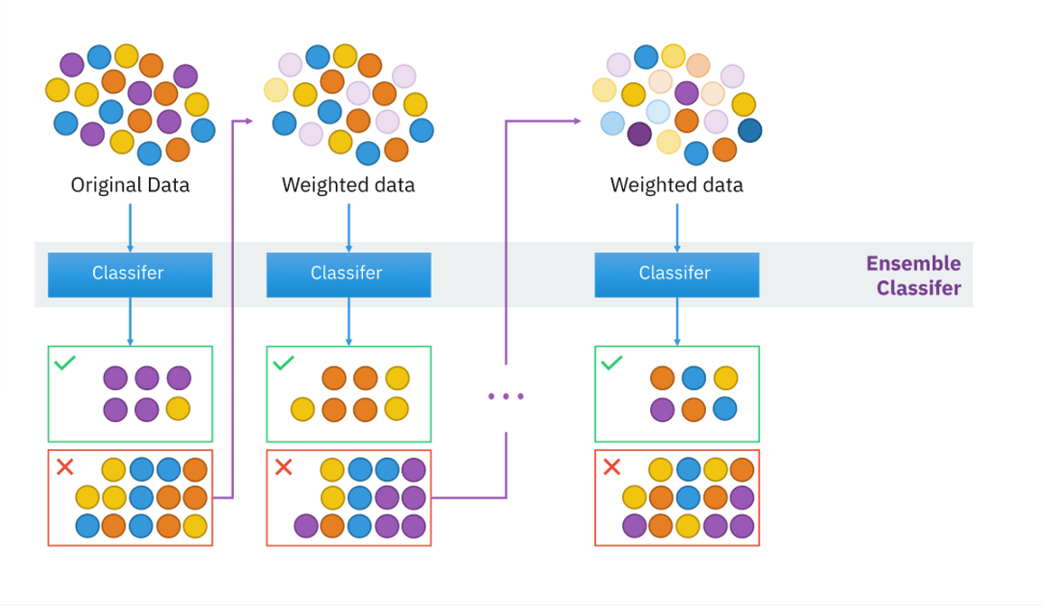
AdaBoosting Regressor

Slide 6
XGBoosting Algorithm
Week3 – Machine Learning
Notes:
NOTE:
To change the image on this slide, select the picture and delete it. Then click the Pictures icon in the placeholder to insert your own image.

Slide 7
XGBoosting Algorithm
XG Algorithm:
XGBoost, or Extreme Gradient Boosting, is a supervised learning algorithm that combines the predictions of multiple models to create a predictive model. It's a leading machine learning library for regression, classification, and ranking problems.
In this algorithm, decision trees are created in sequential form. Weights play an important role in XGBoost. Weights are assigned to all the independent variables which are then fed into the decision tree which predicts results. The weight of variables predicted wrong by the tree is increased and these variables are then fed to the second decision tree. These individual classifiers/predictors then ensemble to give a strong and more precise model. It can work on regression, classification, ranking, and user-defined prediction problems.

Slide 8
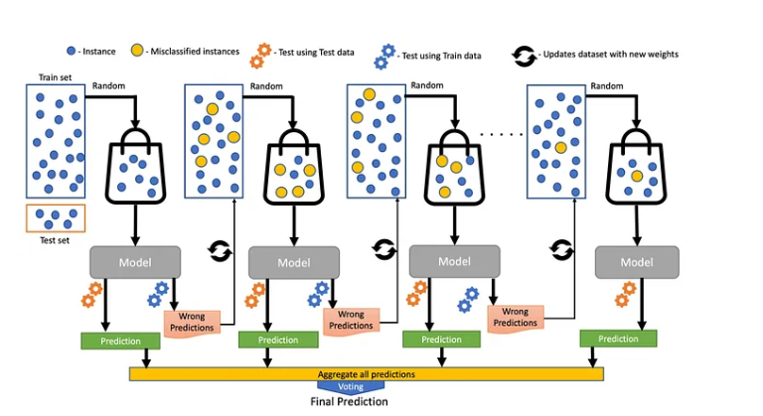
XGBoosting Algorithm

Slide 9
XGBoosting Algorithm
Advantages of XGBoost:
Performance: XGBoost has a strong track record of producing high-quality results in various machine learning tasks, especially in Kaggle competitions, where it has been a popular choice for winning solutions.
Scalability: XGBoost is designed for efficient and scalable training of machine learning models, making it suitable for large datasets.
Customizability: XGBoost has a wide range of hyperparameters that can be adjusted to optimize performance, making it highly customizable.
Handling of Missing Values: XGBoost has built-in support for handling missing values, making it easy to work with real-world data that often has missing values.
Interpretability: Unlike some machine learning algorithms that can be difficult to interpret, XGBoost provides feature importances, allowing for a better understanding of which variables are most important in making predictions.
Disadvantages of XGBoost:
Computational Complexity: XGBoost can be computationally intensive, especially when training large models, making it less suitable for resource-constrained systems.
Overfitting: XGBoost can be prone to overfitting, especially when trained on small datasets or when too many trees are used in the model.
Hyperparameter Tuning: XGBoost has many hyperparameters that can be adjusted, making it important to properly tune the parameters to optimize performance. However, finding the optimal set of parameters can be time-consuming and requires expertise.
Memory Requirements: XGBoost can be memory-intensive, especially when working with large datasets, making it less suitable for systems with limited memory resources.

Slide 10
LightGBM Algorithm
Week3 – Machine Learning
Notes:
NOTE:
To change the image on this slide, select the picture and delete it. Then click the Pictures icon in the placeholder to insert your own image.

Slide 11
LG Algorithm
LG Algorithm:
LightGBM is an ensemble learning framework, specifically a gradient boosting method, which constructs a strong learner by sequentially adding weak learners in a gradient descent manner.
The algorithm is based on gradient boosting and trains decision trees, making it particularly effective for handling structured and unstructured data.
LightGBM uses a histogram-based approach to speed up the training process, which can be a major advantage when dealing with large datasets. The histogram approach groups data into bins, reducing the number of calculations needed to build decision trees. This results in faster training times and more efficient use of resources.

Slide 12
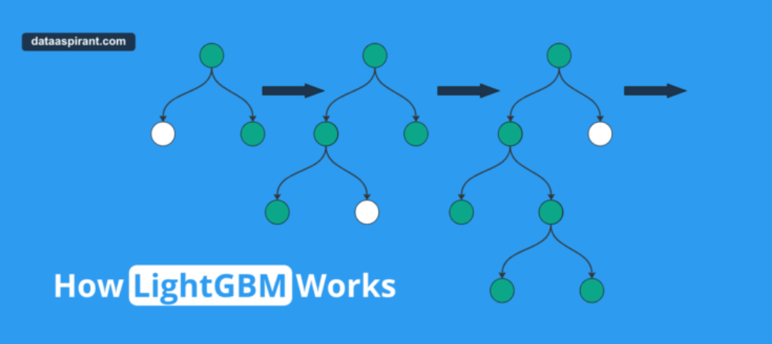
LGBoosting Algorithm
Several key features of LightGBM make it particularly effective, including its use of decision tree learning, a histogram-based approach, leaf-wise tree growth, and regularization.

Slide 13
LGBoosting Algorithm Flow
Data Preprocessing: The first step is to prepare the data for model training. This involves handling missing values, converting categorical features to numeric ones, and scaling the features if required.
Splitting the data: The data is then split into training and validation sets. The training set is used to train the model, and the validation set is used to evaluate the performance of the model during training.
Initialization: LightGBM starts with a single decision tree grown from the root node.
Splitting the nodes: The algorithm then splits the nodes using a gradient-based approach. It calculates the gradients of the loss function with respect to the predicted values and finds the best split that maximizes the reduction in the loss function.
Building the tree: The algorithm continues building the decision tree by recursively splitting the nodes until a stopping criterion is reached. This could be a maximum tree depth, a minimum number of samples per leaf, or a minimum gain in the loss function.
Gradient Boosting: After building the first decision tree, LightGBM creates an ensemble of trees by iteratively adding new trees that correct the errors of the previous trees. Each new tree is trained on the residual errors of the previous trees, i.e., the difference between the predicted and true values.
Regularization: LightGBM applies various regularization techniques to prevent overfitting, such as pruning the tree, limiting the number of leaves, and applying L1 or L2 regularization on the leaf weights.
Prediction: Once the ensemble of trees is trained, LightGBM uses it to make predictions on new data by taking the weighted average of the predictions of all the trees in the ensemble.
Model Evaluation: The performance of the model is evaluated on the validation set using a suitable metric such as mean squared error, accuracy, or AUC-ROC.
Parameter Tuning: Finally, the model hyperparameters are tuned using grid or random search techniques to improve the model's performance.

